Slide 1
L4 Security
EN.600.444/644
Spring 2019
Dr. Seth James Nielson

Slide 2
TCP Protocol
Layer 4 Protocol
Multiplexing (ports)
Reliable Delivery (ack/resend)
Congestion control
Units called *segments*

Slide 3
Review
Ethernet frame
IP packet
TCP segment

Slide 4
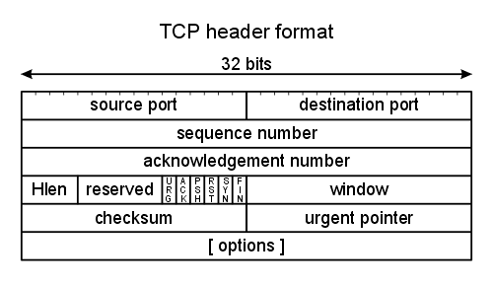
TCP Header

Slide 5
TCP Header FIELDS
Source Port, Destination Port for multiplexing
Sequence Number of the first data byte
Acknowledgement Number of next expected seq. no.
Hlen number of 32-byte words in the TCP header
Window number of bytes willing to receive
Checksum over the header and data

Slide 6
TCP Flags
URG The URGENT POINTER field contains valid data
ACK The acknowledgement number is valid
PSH The receiver should pass this data to the application as soon as possible
RST Reset the connection
SYN Synchronize sequence numbers to initiate a connection.
FIN Sender is finished sending data

Slide 7
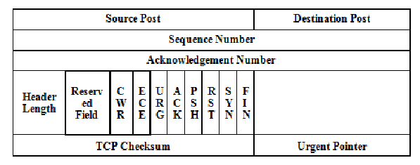
ECN Flags added in RFC 3168
Standard in 2001

Slide 8
TCP Flags (Cont)
CWR – Acknowledges that congestion notification received
ECN – indicates congestion notification via IP layer
(NOTE! Requires ECN capable IP layer!)
Sent until CWR received
Only used if negotiated using TCP options during handshake

Slide 9
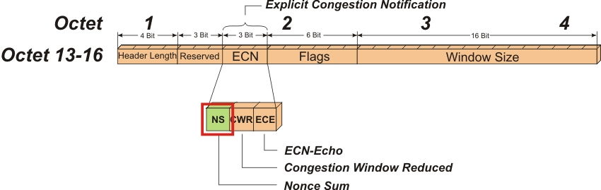
Optional NS flag

Slide 10
One-Bit Nonce
NS is a parity bit used to catch changes to a packet
Because it’s only one bit, a cheater can guess it 50% right
But, over repeated trials (frequent congestion) will get caught

Slide 11
TCP Options
Header can be “extended” with options
Each option can have up to three fields:
Option Type (1 byte)
Option Length (1 byte)
Option data (variable)
Examples include
Selective acknowledgement
ECN

Slide 12
TCP Sequence Numbers
TCP header has a value for seq num and ack num every time
SYN Sequence Number random between 0-4,294,967,295
SYN Ack Num should be 0 (but any value should be ignored)
SYN-ACK Seq Num also random
SYN-ACK Ack Num is SYN Seq Num + 1
(SYN-ACK) ACK Seq Num is SYN Seq Num + 1
(SYN-ACK) ACK Ack Num is SYN-ACK Seq Num + 1

Slide 13
Data Sequence Numbers
Technically, there is only one packet type in TCP
Flags simply indicate how the values can be used
Sequence number is set every time
But only increased by the length of the data
(or increased by +1 for SYN and FIN)
Ack field indicates that the ACK number is valid

Slide 14
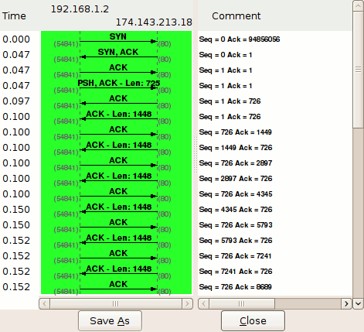
Wireshark Trace

Slide 15
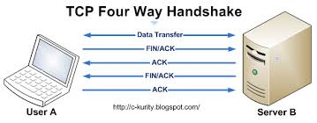
TCP Shutdown

Slide 16
Security
Obviously, TCP is not designed with security in mind
No confidentiality!
No authentication!
No integrity (checksum is not cryptographic)
No secure availability either!
End any connection with RST

Slide 17
SSLv2
SSL = Secure Sockets Layer
SSLv1 was never published
SSLv2 was published 11/29/1994, last updated 2/9/1995

Slide 18
SSL Record Layer
All data encapsulated in a “Record”
Header
Data
Header includes record length, and some meta information
Data portion includes
Mac data
Actual data
Padding data

Slide 19
SSLV2 Record MAC
MAC-DATA = HASH[ SECRET, ACTUAL-DATA, PADDING-DATA, SEQUENCE-NUMBER ]
Sequence is 32bit number, starts at 0 and increments
SECRET is the CLIENT-WRITE-KEY for the client.
SECRET is the SERVER-WRITE-KEY for the server
CLIENT-READ-KEY = SERVER-WRITE-KEY

Slide 20
SSLV2 Handshake
client-hello C -> S: challenge, cipher_specs
server-hello S -> C: connection- id,server_certificate,cipher_specs
client-master-key C -> S: {master_key}server_public_key
client-finish C -> S: {connection-id}client_write_key
server-verify S -> C: {challenge}server_write_key
server-finish S -> C: {new_session_id}server_write_key

Slide 21
Key Derivation
KEY-MATERIAL-0 = MD5[ MASTER-KEY, "0", CHALLENGE, CONNECTION-ID ]
KEY-MATERIAL-1 = MD5[ MASTER-KEY, "1", CHALLENGE, CONNECTION-ID ]
CLIENT-READ-KEY = KEY-MATERIAL-0[0-15]
CLIENT-WRITE-KEY = KEY-MATERIAL-1[0-15]

Slide 22
SSLV2 Session Recovery
client-hello C -> S: challenge, session_id, cipher_specs
server-hello S -> C: connection-id, session_id_hit
client-finish C -> S: {connection-id}client_write_key
server-verify S -> C: {challenge}server_write_key
server-finish S -> C: {session_id}server_write_key

Slide 23
Client Auth
Server may request client cert
Send a challenge to authenticate

Slide 24
Bulk Data Transmission
Use write key to create data
C = {P}write-key
Use same write key to MAC data
MAC = Hash( write-key, C, Padding, Sequence)

Slide 25
SSLV3
Netscape Memo March 1996
“Layered Protocol” (e.g., record layer, message layer)
“Stateful”
“SSL takes messages to be transmitted, fragments the data into manageable blocks, optionally compresses the data, applies a MAC, encrypts, and transmits the result. Received data is decrypted, verified, decompressed, and reassembled, then delivered to higher level clients”

Slide 26
SSLv3 State
Session identifier – arbitrary bytes
Peer certificate – (may be null)
Compression method
Cipher spec – specifics bulk data, MAC, hash size, etc
Master secret - 48-byte secret shared
Is resumable

Slide 27
SSLv3 Connection State
There can be multiple connections within the same session
Server and client random
Client write key
Client write MAC secret
Server write key
Server write MAC secret
IV’s and sequence numbers

Slide 28
Record Layer
Fragmentation
The record layer fragments information blocks into SSLPlaintext records of 2¹⁴ bytes or less
Record layer now includes:
Version
Higher SSL type
Supports compression

Slide 29
New MAC
hash(MAC_write_secret + pad_2 + hash (MAC_write_secret + pad_1 + seq_num + length + content));
pad_1 - 0x36 repeated 48x for MD5 this or 40x for SHA.
pad_2 - 0x5c repeated the same number of times.
hash – chosen by cipher suite

Slide 30
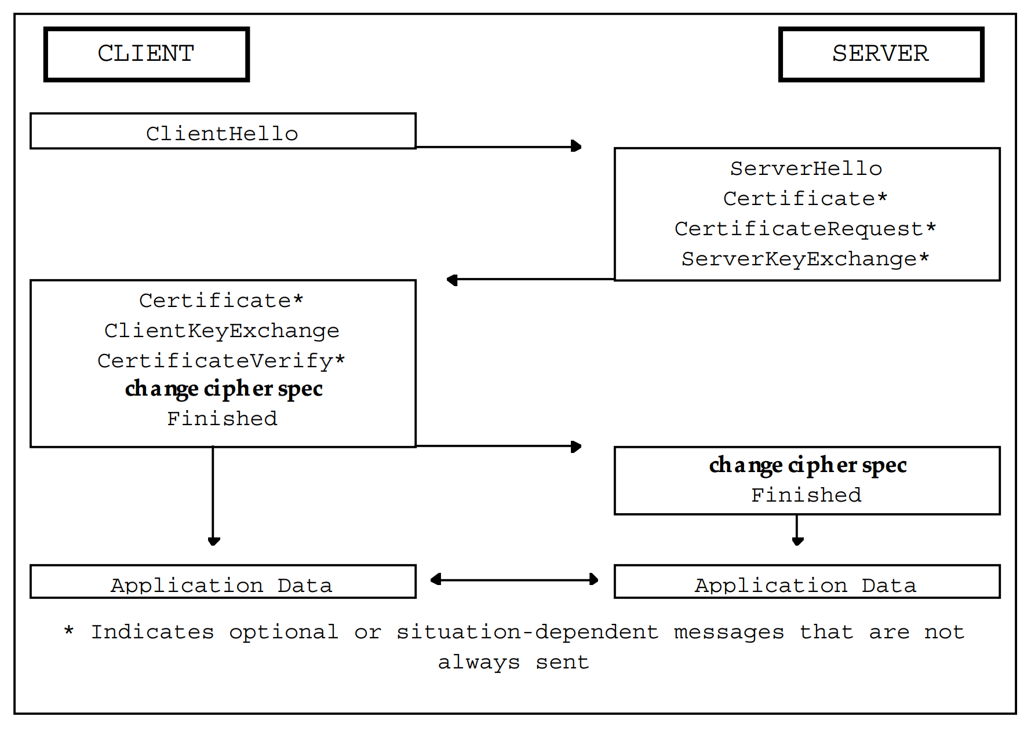
Handshake Changes

Slide 31
SSLv3 Handshake Changes
Certs can now be a chain (before, only 1!)
Many key exchange options including DH
Hash of all handshake messages at the end
md5_hash MD5(master_secret + pad2 + MD5(handshake_messages + Sender + master_secret + pad1));
sha_hash SHA(master_secret + pad2 + SHA(handshake_messages + Sender + master_secret + pad1));

Slide 32
Master Secret
Derived from pre-master secret
Pre-master secret computed directly from DH
Or, can exchange pre-master secret encrypted with pub key
master_secret = MD5(pre_master_secret + SHA(‘A’ + pre_master_secret +ClientHello.random + ServerHello.random)) + MD5(pre_master_secret + SHA(‘BB’ + pre_master_secret + ClientHello.random + ServerHello.random))
+ MD5(pre_master_secret + SHA(‘CCC’ + pre_master_secret ClientHello.random + ServerHello.random));

Slide 33
Deriving Secrets
key_block =
MD5(master_secret + SHA(‘A’ + master_secret + ServerHello.random + ClientHello.random))
+ MD5(master_secret + SHA(‘BB’ + master_secret + ServerHello.random + ClientHello.random))
+ MD5(master_secret + SHA(‘CCC’ + master_secret + ServerHello.random ClientHello.random))
+ [...];

Slide 34
Keys from Key Block
client_write_MAC_secret[CipherSpec.hash_size]
server_write_MAC_secret[CipherSpec.hash_size]
client_write_key[CipherSpec.key_material]
server_write_key[CipherSpec.key_material]
client_write_IV[CipherSpec.IV_size]
server_write_IV[CipherSpec.IV_size]

Slide 35
TLS 1.0
Very similar to SSLv3
Different key derivation and MAC
Not compatible

Slide 36
TLS 1.0 HMAC
Standardized HMAC, RFC 2104
H(K XOR opad, H(K XOR ipad, text))
Ipad: the byte 0x36 repeated B times
Opad: the byte 0x5C repeated B times
B: block size of H (64 bytes for SHA-1)
K: Key

Slide 37
TLS 1.0 MAC
HMAC_hash(MAC_write_secret, seq_num + TLSCompressed.type +TLSCompressed.version + TLSCompressed.length + TLSCompressed.fragment));

Slide 38
TLS 1.0 Data Expansion
P_hash(secret, seed) = HMAC_hash(secret, A(1) + seed) +
HMAC_hash(secret, A(2) + seed) +
HMAC_hash(secret, A(3) + seed) + ...
A() is defined as:
A(0) = seed
A(i) = HMAC_hash(secret, A(i-1))

Slide 39
TLS 1.0 PRF
Pseudo Random Function
PRF(secret, label, seed) = P_MD5(S1, label + seed) XOR P_SHA-1(S2, label + seed);
S1 = first half of secret
S2 = second half of secret

Slide 40
TLS 1.0 Key Block
key_block = PRF(SecurityParameters.master_secret, "key expansion", SecurityParameters.server_random + SecurityParameters.client_random);
Session keys derived from key_block similar to SSLv3

Slide 41
TLS 1.0 Finished Msg
verify_data = PRF(master_secret, finished_label, MD5(handshake_messages) + SHA-1(handshake_messages)) [0..11];

Slide 42
TLS 1.0 Bulk Data Transfer
The record layer encapsulates a bulk data fragment
struct {
ContentTypetype;
ProtocolVersionversion;
uint16 length;
opaque fragment[TLSPlaintext.length];
} TLSPlaintext;
(Opaque just means raw bytes)

Slide 43
Fragment Types
select (CipherSpec.cipher_type) {
case stream: GenericStreamCipher;
case block: GenericBlockCipher;
} fragment;

Slide 44
Stream Type
stream-ciphered struct {
opaque content[TLSCompressed.length];
opaque MAC[CipherSpec.hash_size];
} GenericStreamCipher;

Slide 45
CBC Block Cipher
block-ciphered struct {
opaque content[TLSCompressed.length];
opaque MAC[CipherSpec.hash_size];
uint8 padding[GenericBlockCipher.padding_length];
uint8 padding_length;
} GenericBlockCipher;

Slide 46
Change from SSLV3
The contents of “padding” not specified in SSLV3
InTLS 1.0, specified as:
“Each uint8 in the padding data vector must be filled with the padding length value.”

Slide 47
To Clarify
Sample 10 legal padding bytes in SSLV3:
0xAA 0xBB 0xCC 0xDD 0xEE 0xFF 0x00 0x11 0x22 0x33 0xA
(NOTE:0xA=10=Length)
Only 10 legal padding bytes in TLS 1.0:
0xA 0xA0xA0xA0xA0xA0xA0xA0xA0xA0xA
(NOTE:last0xA is still length!)

Slide 48
NOTE: Auth then Encrypt
Both SSLv3 and TLS 1.0 chose to auth then encrypt
Look at the data structure: The MAC is included in the plaintext
ALSO NOTE: DID NOT INCLUDE THE PADDING!!!!

Slide 49
SSLV3 Poodle Attack
SSLV3’s lack of a padding specification resulted in an attack
You could use a “paddingoracle” attack to decrypt bytes
Approximately, 256 messages would reveal one byte

Slide 50
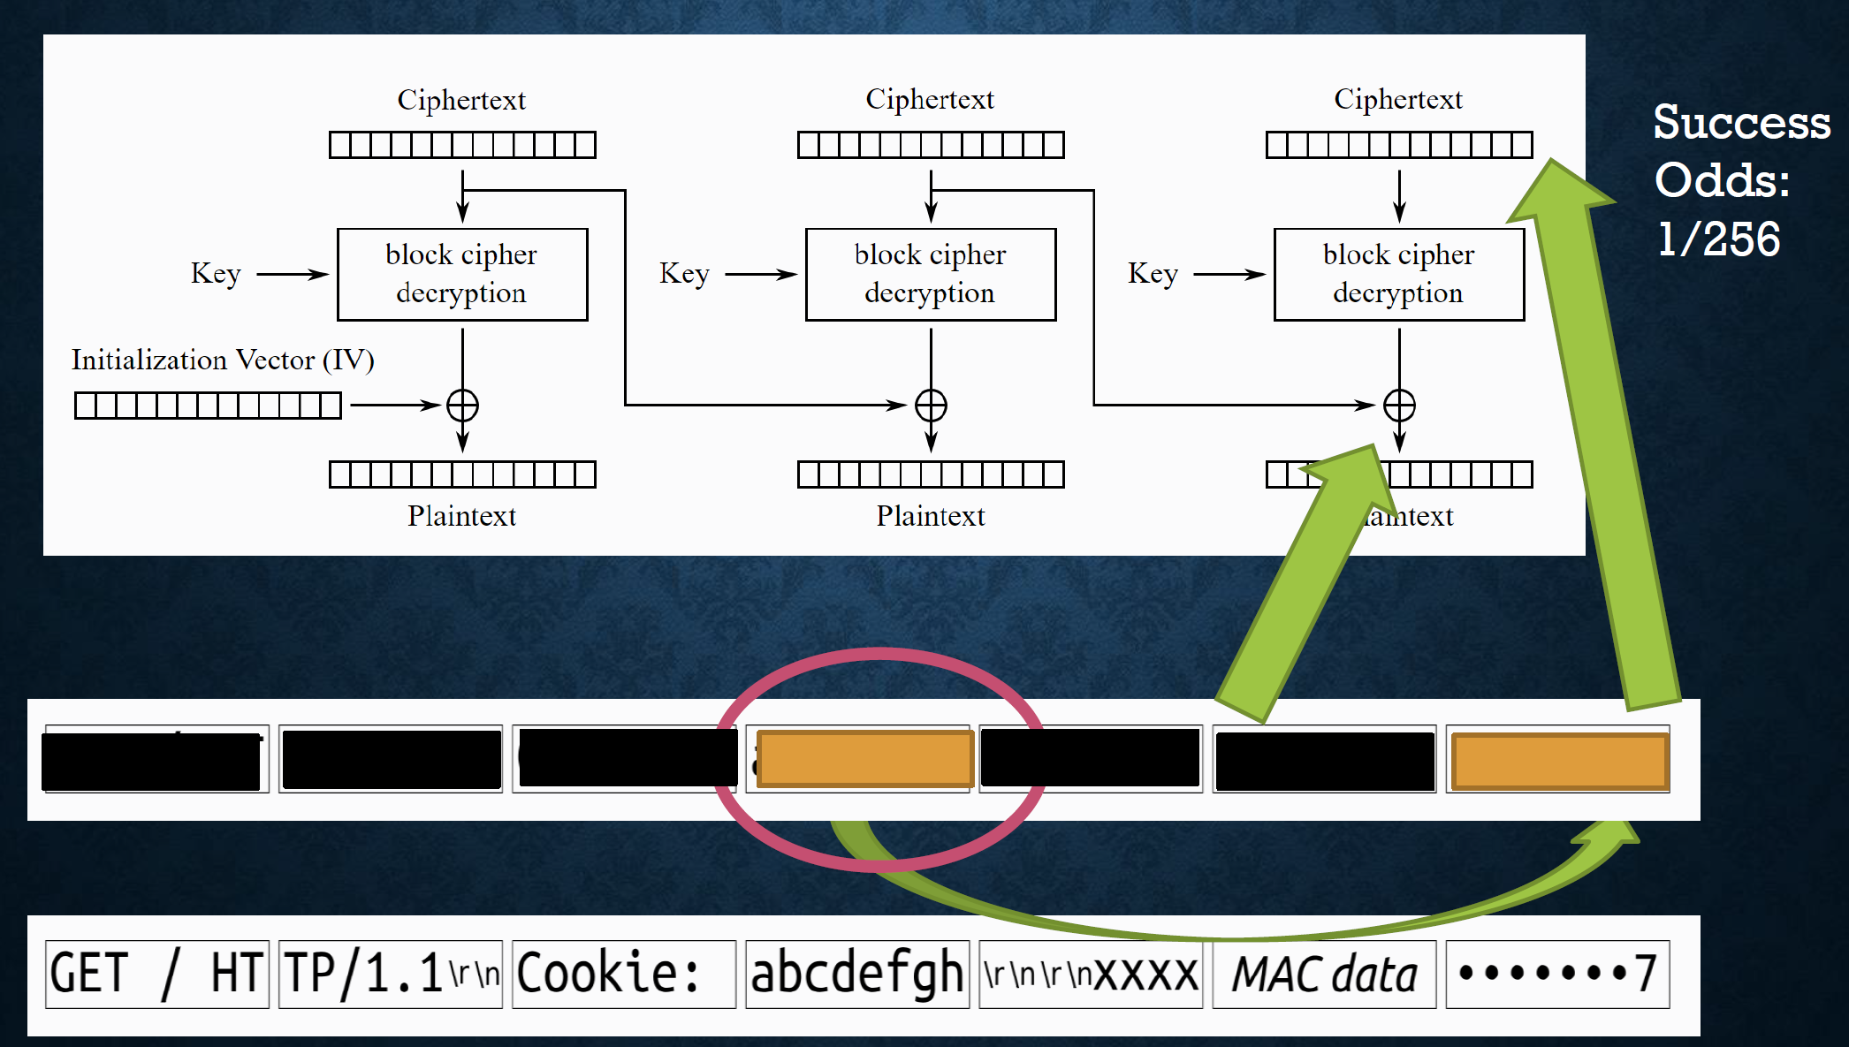
Padding Oracle Attack

Slide 51
Get the Next Byte

Slide 52
Attacking TLS 1.0
POODLE would use an MITM to force a downgrade to SSLv3
OR ,some TLS1.0 versions DIDN’T CHECK the PADDING!

Slide 53
TLS 1.1
Attempted to fix various problems with TLS 1.0
CBC IV’s (explicit v implicit)
Now included in record
Prior to1.1, IV was last ciphertext block of previous record
Padding errors now just return error “bad_record_mac”
•Sometimes called the forgotten middle child

Slide 54
TLS 1.2
PRF replaced MD5/SHA1 with cipher suite specific function
Signatures explicitly identify hashing algorithm
Support for authenticated encryption
Changes to resist known attacks against previous versions

Slide 55
TLS 1.2 Review

Slide 56
Connection State Contains:
Connection end –“client” or “server”
PRFalgorithm
Bulk encryption algorithm
MACalgorithm
Compressionalgorithm
Master secret
Client random
Server random

Slide 57
Connection State Contains:
Compression state
Cipherstate
MAC key
Sequence number

Slide 58
Connection State Security Parameters

Slide 59
Derived Values

Slide 60
TLS 1.2 Handshake

Slide 61
Client Hello

Slide 62
Client Hello Example

Slide 63
TLS 1.2 Extensions Example

Slide 64
Server Hello

Slide 65
Server Cert/Key Exchange

Slide 66
Client Key Exchange

Slide 67
Finished
verify_data_lengthcanbespecifiedbytheciphersuite,
otherwise, is 12.

Slide 68
PRF
In the base RFC, always uses SHA-256
Newcipher suites must define their PRF function
SHOULDuseSHA-256

Slide 69
Data Expansion

Slide 70
PRF Definition

Slide 71
Computing Master Secret

Slide 72
Computing Keys

Slide 73
Change Cipher Suite
Single Byte. Indicates next message will be encrypted

Slide 74
Record Layer Types

Slide 75
Stream/Block Defs

Slide 76
New: AEAD Type

Slide 77
AEAD
Authenticated Encryption with Additional Data
Plaintext is simultaneously encrypted and integrity protected.
Default TLS 1.2 algorithms: CCM and GCM
No MAC key

Slide 78
TLS 1.2 ATtacks
ROBOT
Return Of Bleichenbacher’s Oracle Threat
Applies primarily to RSA encryption (not signatures)
The RSA encryption in TLS 1.2 uses PKCS 1.5 padding
Known padding oracle attack
•Countermeasures built in to TLS 1.2, rather than disabling
•Countermeasures are complicated, and many are vulnerable

Slide 79
TLS 1.3
Algorithms are ALL authenticated encryption
Handshake messages after the ServerHelloare now encrypted
Key derivation based off Extract-and-Expand Key Derivation Function (HKDF)
Compression, custom DHE groups, and DSA removed
RSA signature padding now uses PSS

Slide 80
TLS 1.3 Handshake

